Slide 1



Othello AI
Project Info 407 – Artificial Intelligence
PRESENTED FOR:
Dr Kifah TOUT
Dr Rami BAIDA
PRESENTED BY:
Fatima LAKKIS – 92209
Fatima EZZEDDINE - 87179

Slide 2
Plan
01
Overview
02
Algorithmic View
03
Evaluation Function
04
Final Result

Slide 3
Overview
Game Idea
Min – Max Algorithm
Othello or Reversi is a strategy board game played between 2 players on 8x8 uncheckered board.
Maximizing the computer’s behavior, and minimizing the opponent.
Challenge?
Alpha-Beta Pruning
Find the best evaluation function!
Almost impossible to generate and examine complete tree.
Less time, less complexity.

Slide 4
Algorithmic View
Min-Max with Alpha-Beta Pruning

Slide 5
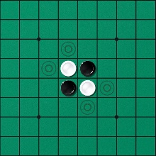
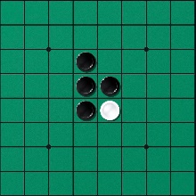
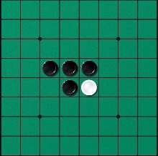
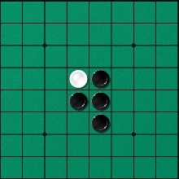
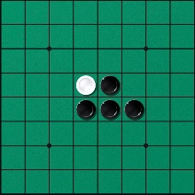
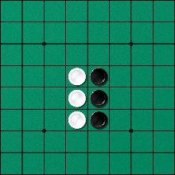
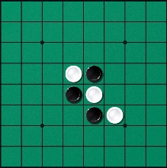
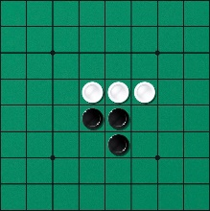
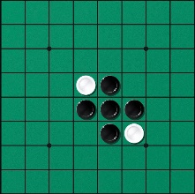
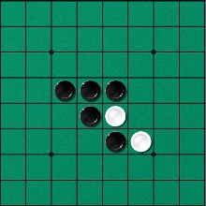
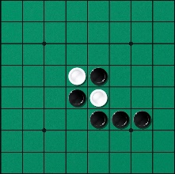
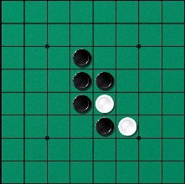
Search Tree
MAX
MIN
MAX
MIN

Slide 6

Evaluation
Function
01
Main Component
02
Game Stages

Slide 7
Evaluation Function Components
Disc Difference
Mobility or Legal Moves Count
Corner Squares
Stability
Parity
Square Weights
The goal of the game is to have more discs than the opponent, so simply compute the two players disc balance at each search node.
The specialty of these squares is that once captured, they cannot be flanked by the opponent.
This is quantitative representation of how vulnerable it is to being flanked.
Measures who is expected to make the last move/ply of the game.
Assigns weights to squares so as to avoid giving the opponent a corner.
The static board implicitly captures the importance of each square on the board..
Restrict your opponent’s mobility and to mobilize yourself.
Mobilizing yourself would imply a vast number of moves to choose from.

Slide 8
Game Stage
Corners.
Stability.
Mobility.
Square weights.
less than 20 discs
Opening
01
Corners.
Stability.
Mobility.
Square weights.
Disc difference.
Parity.
02
Midgame
between 20 and 58 discs
Corners.
Stability.
Disc difference.
Parity.
03
59 discs or more
Endgame

Slide 9
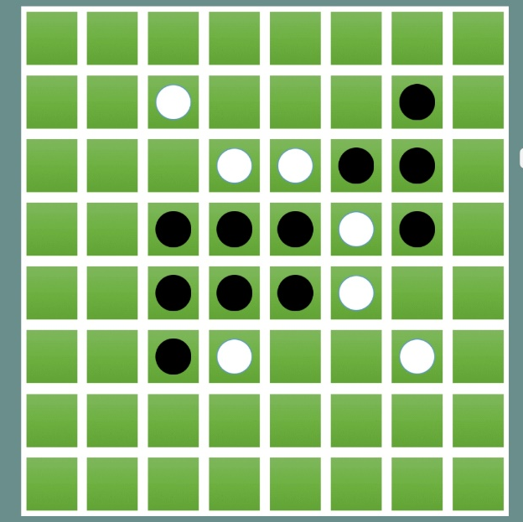
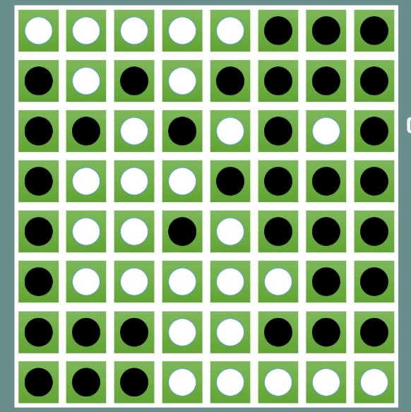
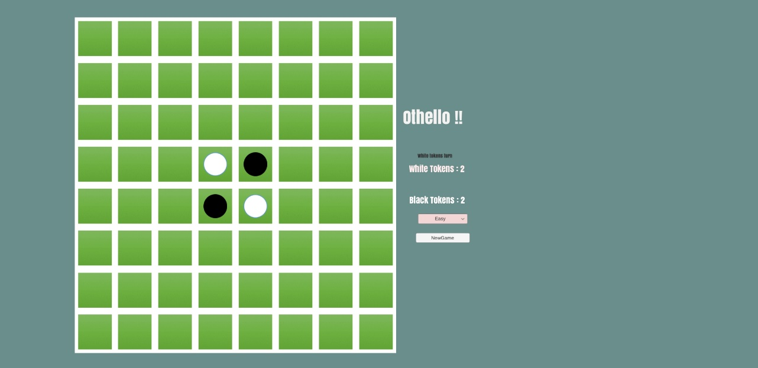
Final Result
We evaluated the importance of adding heuristics to enhance Othello game play. However, this application can be upgraded by using Evolutionary Neural Network, Negascout, MTD-f…
Several heuristics are also used to reduce the size of the searched tree: good move ordering, transposition table and selective Search.

Slide 10
Thank you for your attention ☺
Questions?

